Slide 1
REINFORCEMENT LEARNING - GAME

Slide 2
REINFORCEMENT LEARNING
Reinforcement learning (RL) is an area of machine learning concerned with how software agents ought to take actions in an environment in order to maximize the notion of cumulative reward
RL is teaching a software agent how to behave in an environment by telling it how good it’s doing.
RL is a feedback-based machine learning technique in which an agent takes an action based on the prediction.

Slide 3
More Detail in Reinforcement Learning
Reinforcement learning is one of three basic machine learning paradigms, alongside supervised learning and unsupervised learning.
The environment is typically stated in the form of a Markov decision process (MDP), because many reinforcement learning algorithms for this context use dynamic programming techniques.

Slide 4
DEEP Q-LEARNING
This approach extends reinforcement learning by using a deep neural network to predict the actions.
Q-Learning is required as a pre-requisite as it is a process of Q-Learning creates an exact matrix for the working agent which it can “refer to” to maximize its reward in the long run.
‘Q’ refers to Quality of the actions.

Slide 5
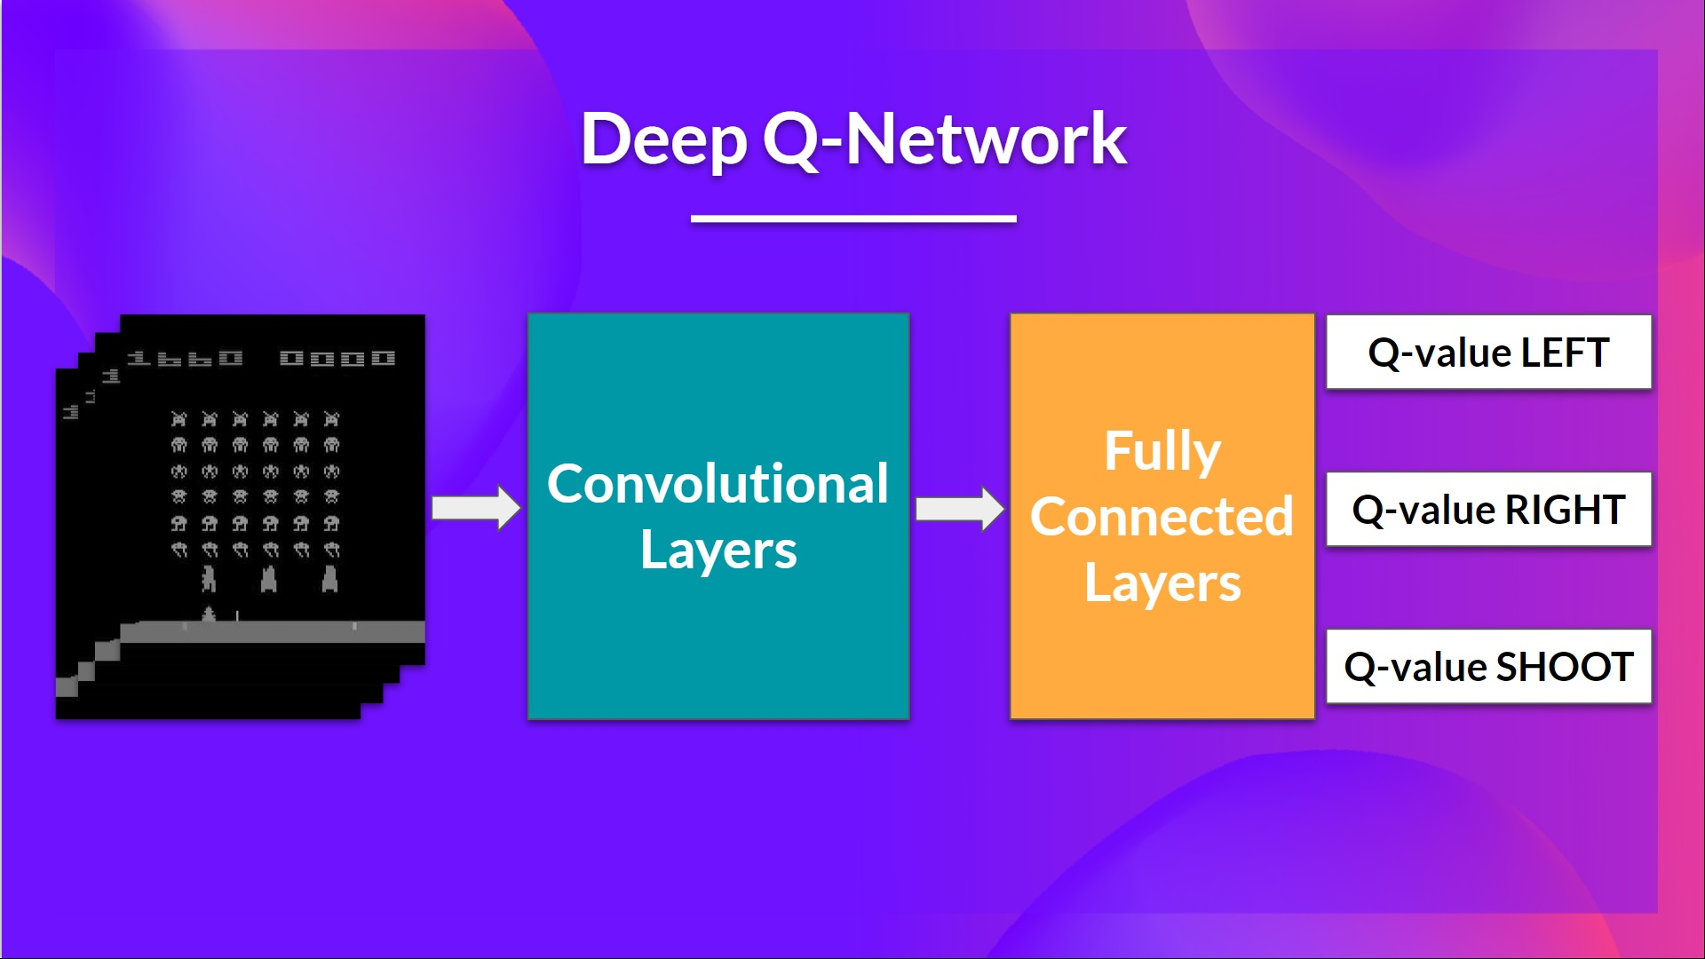
DEEP Q-LEARNING PROCESS DIAG

Slide 6
PROJECT OVERVIEW
Agent:
game
model
Training:
state = get_state(game)
Action = get_move(state):
Model.predict()
Reward,game_over,score = game.play_step(action)
New_state = get_state(game)
Remember
Model.train()

Slide 7
PROJECT OVERVIEW - 2
Game :
Play_step(action)
-> reward,game_over,score
Model(Pytorch):
Linear_Qnet(DQN)
Model.predict(state)

Slide 8
STATE AND ACTIONS
State(11 values):
[danger straight, danger right, danger left , direction left, direction right, direction up, direction down , food left, food right , food up , food down]
Action:
[1,0,0] -> straight
[0,1,0] -> right turn
[0,0,1] -> left turn

Slide 9
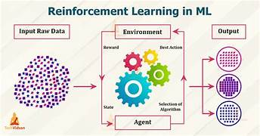
FLOW DIAGRAM

Slide 10
DEEP Q-LEARNING
0. Init Q value(= init model)
1. Choose action (model.predict(state))
2. Perform action
3. Measure reward
4. Update Q value(+ train model)

Slide 11

BELLMAN EQUATIONS

Slide 12
Q UPDATE RULE SIMPLIFIED
Q = model.predict(state0)
Qnew = R + gamma . Max(Q(state1)
Loss = square((Qnew – Q))
Mean Squared Error

Slide 13
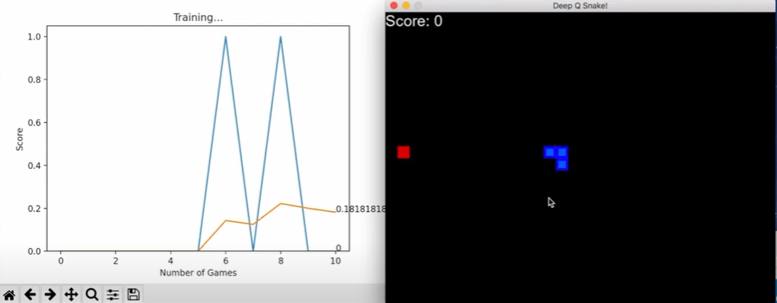
RESULT

